Slide 1
CIS 3370 IDS Final Project: Encrypted Traffic Analysis for Malware Detection
By Jacob Blanco and Bryan Mileski

Slide 2





Milestone 1:
Preparation and Setup
Company Name
Quarter
Month Year
Environment: Kali Linux Virtual Machine
Dataset: UNB CIC-IDS-2018 dataset
  PCAP files from Thursday-15-02-2018
Tools:
  Zeek - for network traffic logs
  Google Colab and Jupyter Notebook - write a script to organize log data and create a ML model that can make predictions
  Elasticsearch and Kibana - ingesting ML model predictions and visualize the data
  Github - collaborate and document the project

Slide 3

Milestone 2:
Zeek Log Extraction
Company Name
Quarter
Month Year
Used Zeek to monitor live network traffic
Generated structured log files such as:
conn.log (connections)
http.log (web traffic)
dns.log (DNS queries)
Extracted logs into CSV format for further analysis
Transform raw network traffic into structured, analyzable security data
Enable detection of suspicious network behavior at scale

Slide 4
Milestone 2:
Parsing
How We Parsed the Data
Converted Zeek logs into structured tables
Cleaned and normalized fields (timestamps, bytes, protocols)
Prepared the dataset for:
  Machine learning
  Visualization in Elastic / dashboards
Created a clean, structured dataset ready for:
  Security analysis
  Threat detection
  Traffic visualization

Slide 5
Milestone 3:
Feature engineering & data processing
Company Name
Quarter
created a Jupyter Notebook in Google Colab
  loads zeeklogs.zip and unzips the files
  merges conn_df and ssl_df into a sessions DataFrame, combining both information from both logs
  Engineers new features, which are later ingested into the ML model for predictions
  Heuristic Labeling - labels connections or traffic with the top 5% longest duration/largest bytes as malicious

Slide 6
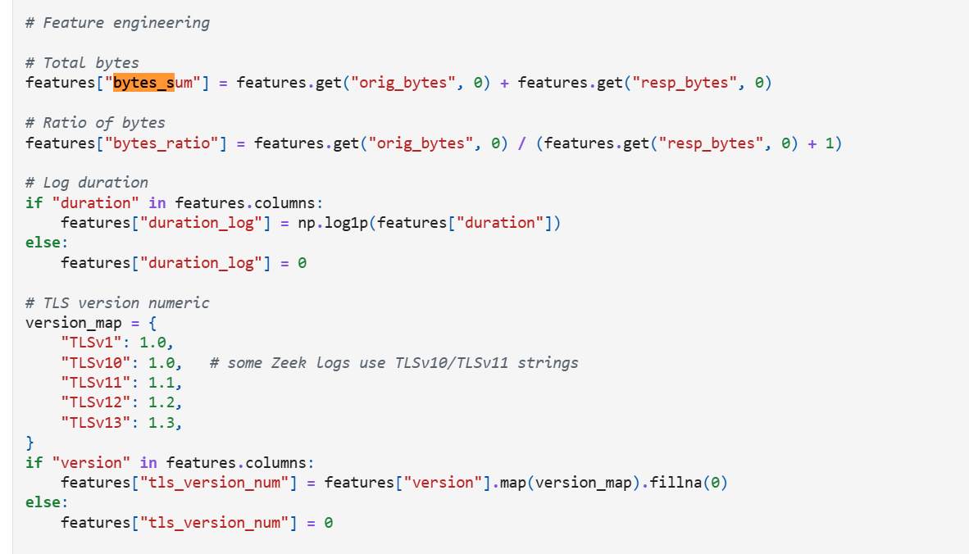
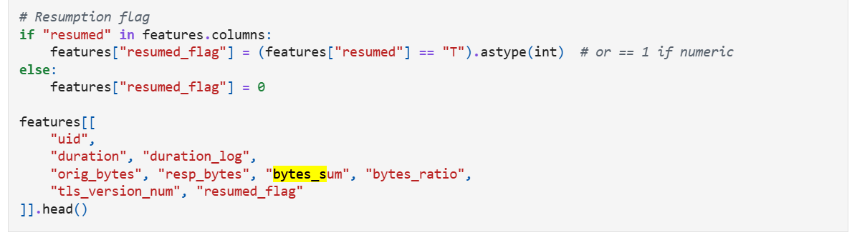
Milestone 3 continued…
Engineering key features
Company Name
bytes_sum: Total traffic exchanged (Original bytes + Response bytes).
bytes_ratio: Ratio of data sent vs. data received (Indicates potential unidirectional data exfiltration or scanning).
duration_log: Log of the flow time (Normalizes timing data to prevent outliers from dominating).
tls_version_num: Converts the text TLS version (e.g., TLSv12) into a number (1.2).
resumed_flag: Binary flag (0/1) showing if the connection used a resumed TLS session.

Slide 7
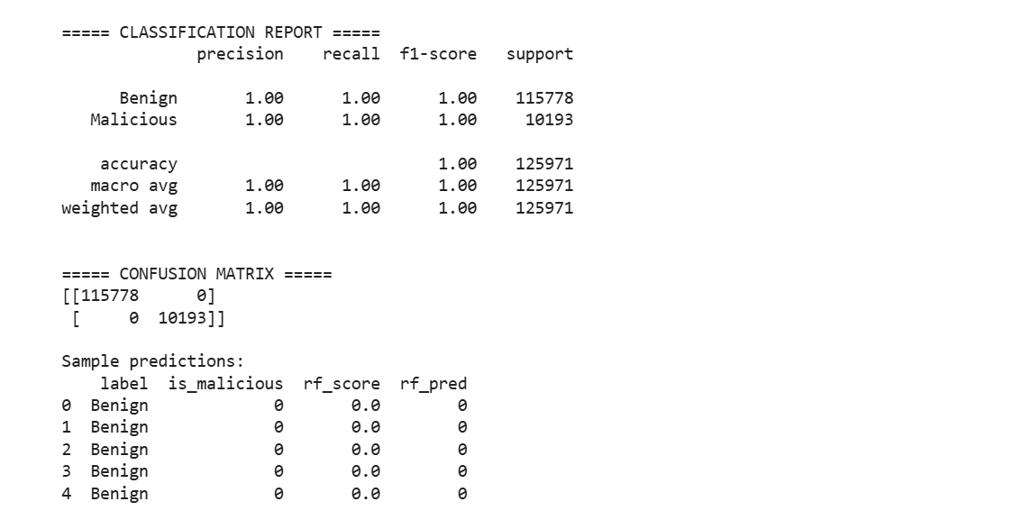
Milestone 4:
Model Training & Evaluation
Random Forest Classifier
  acts like a group that votes whether something is malicious (1) or benign (0)
  fed numerical features such as bytes_ratio, duration, tls_version_num
  outputs rf_score (probability of being malicious) and rf_pred (final 0/1 prediction)
Training and Generalization
  Data Split: dataset split into 70% for training (learning the patterns) and 30% for testing its performance
  ML model looks at the traffic classified as malicious from heuristic label, but goes a step further to look at other features of that traffic
Evaluation
  Confusion matrix: shows where the model succeeded and failed
  classification report: shows final scores (precision and recall)

Slide 8
Milestone 5:
Integration with Elasticsearch
Company Name
Quarter
Month Year
Purpose
  Store and analyze large volumes of network security data efficiently
  Enable fast searching, filtering, and visualization of network activity
How We Integrated Elasticsearch
  Converted parsed Zeek session data into Elasticsearch-ready CSV format
  Defined structured fields for:
    IP addresses
    Ports and protocols
    Connection duration and byte counts
    Security labels and prediction scores
  Imported the dataset into Elasticsearch
  We then made graphs with the information

Slide 9
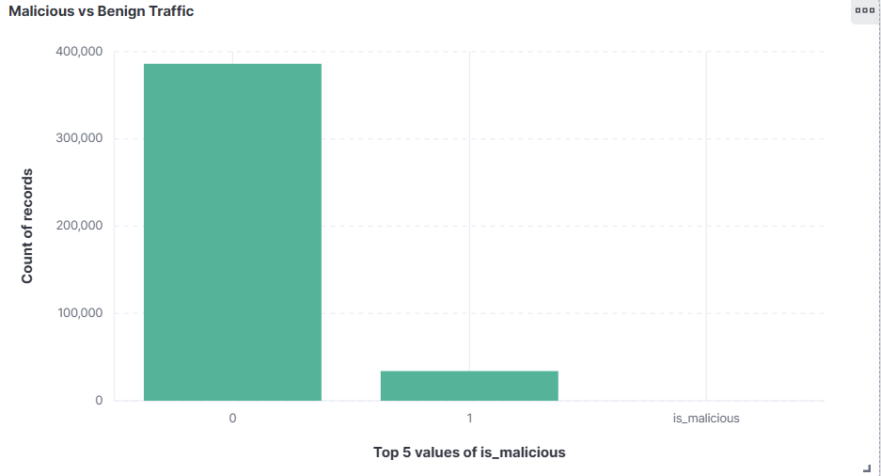
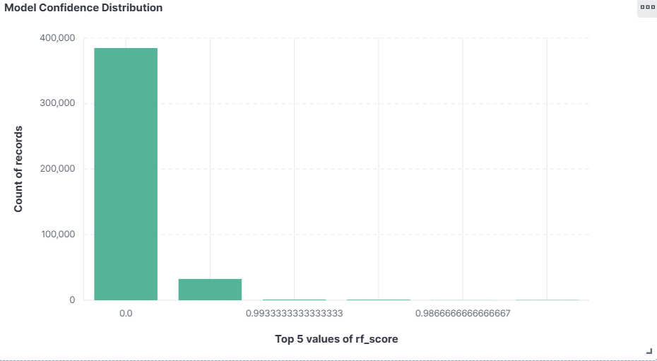
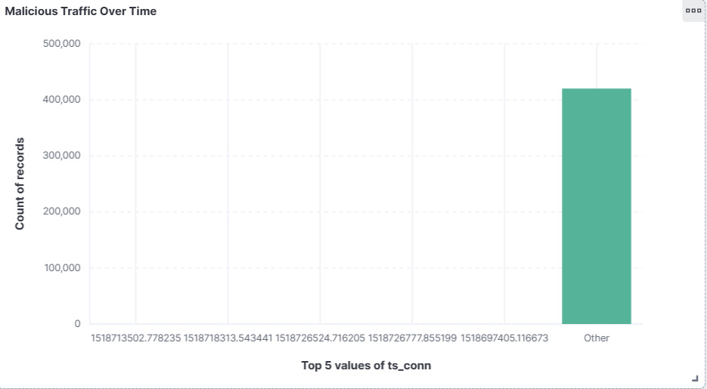
Milestone 6:
Kibana Dashboard & Data Visualization
Company Name
Quarter
Month Year

Slide 10
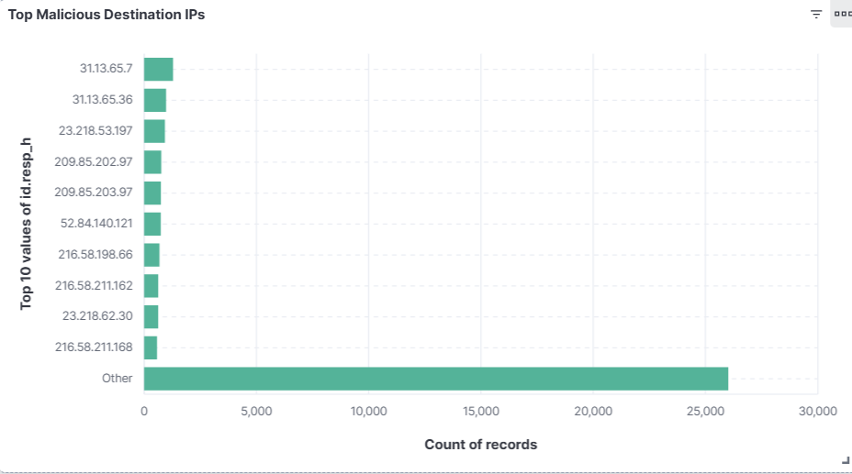
Milestone 6 cont’d

Slide 11
Thank you
Company Name
Quarter
Month Year

